Slide 1

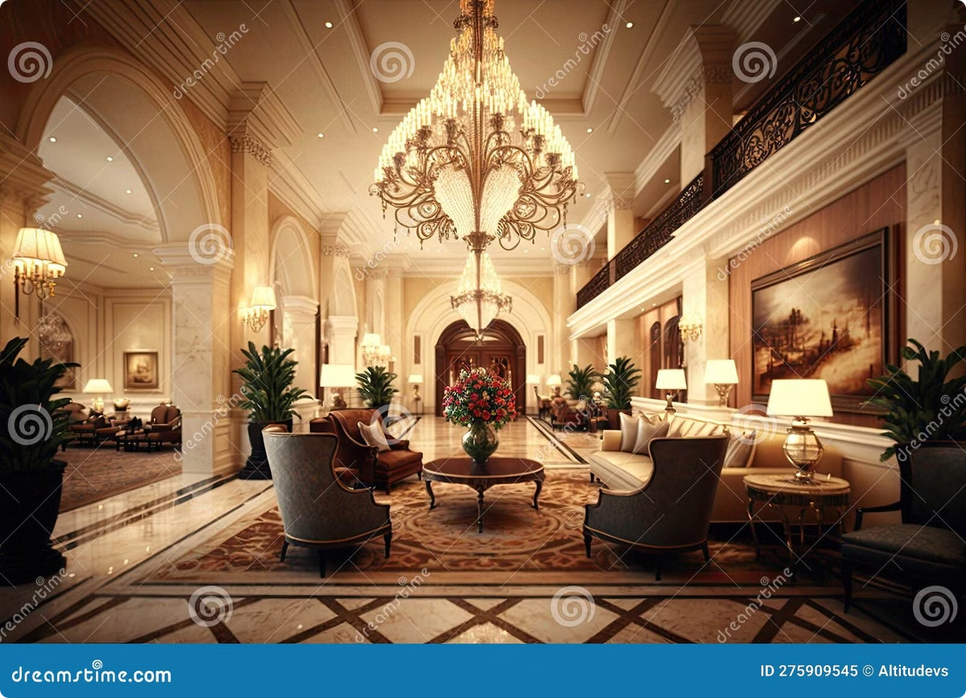

Hotel Booking System
Naresh Kumar .C
09.09.2024

Slide 2

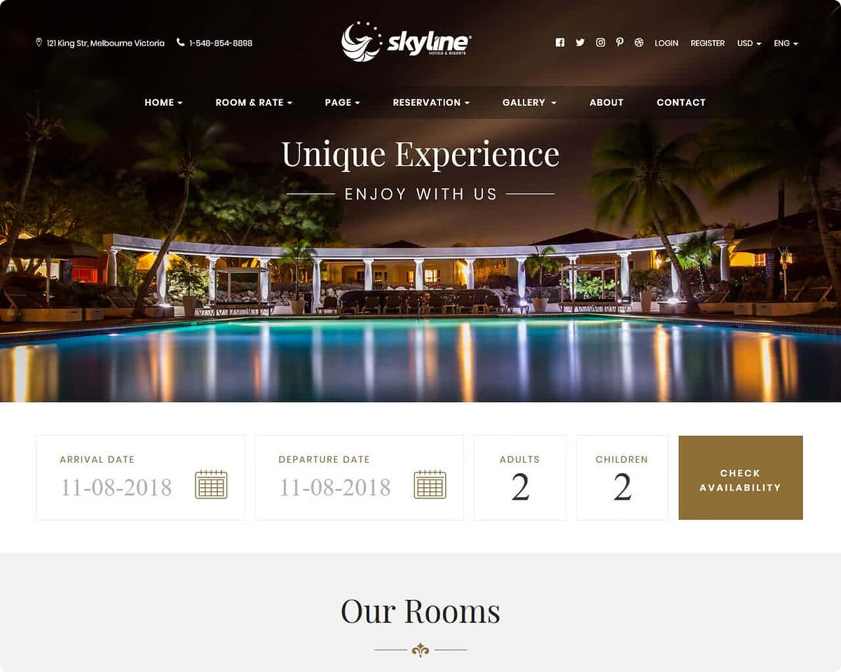
Aim of the Project
The primary aim is to design and implement
a user-friendly system that facilitates
seamless hotel bookings for customers.

Slide 3

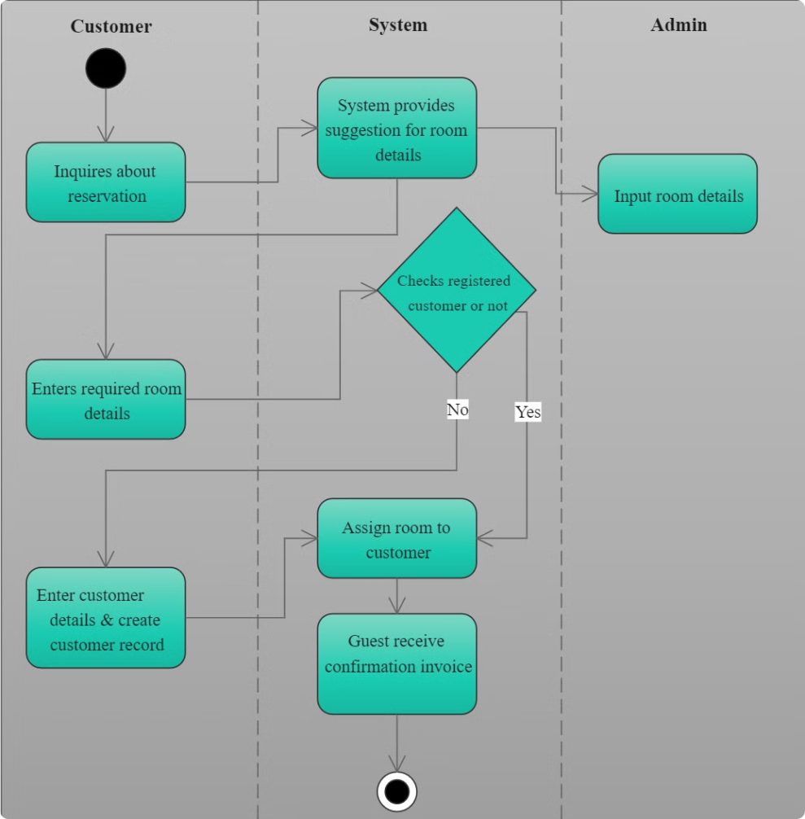
Business Problem
1
Clunky Interfaces
2
Limited Functionality
Many systems have outdated interfaces that are difficult to navigate.
Some systems lack essential features, such as real-time availability or flexible payment options.
3
Poor Customer Support
Customers often face difficulties in accessing support and resolving booking issues.

Slide 4




Project Description
Customer Registration
Allow users to create accounts and manage their booking preferences.
Hotel Management
Enable hotel staff to manage room availability, pricing, and customer details.
Booking Confirmation
Generate booking confirmations with detailed information about the reservation.

Slide 5

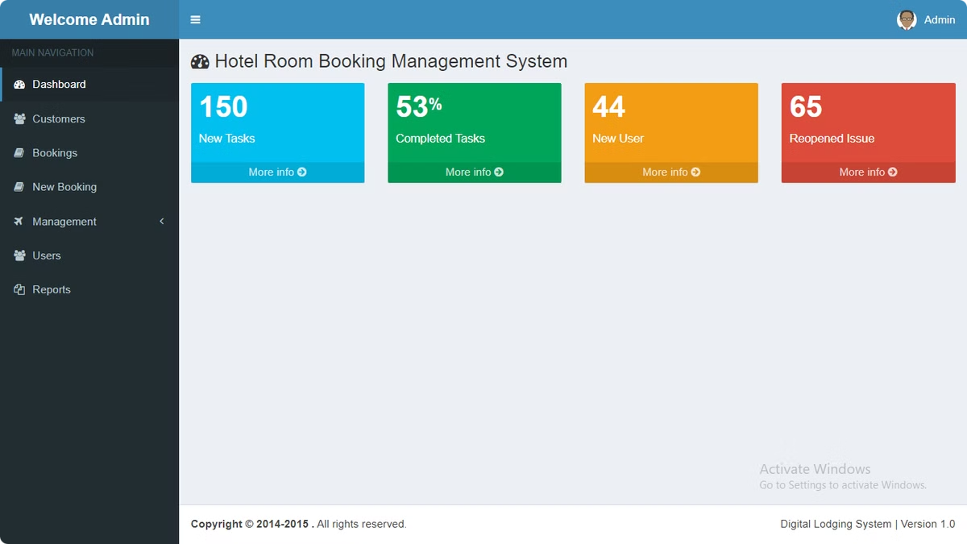
Input Versatility with Error Handling and Exception Handling
Input Validation
Ensure that user input is valid and adheres to the defined data types and formats.
Error Handling
Handle unexpected errors gracefully and provide informative messages to users.

Slide 6

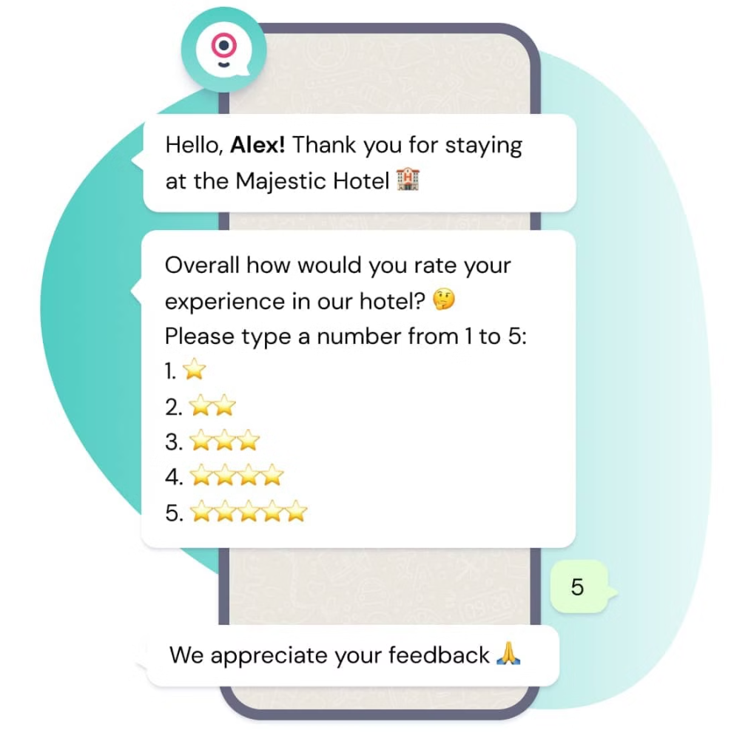
Results and Outcomes
1
Increased Bookings
The user-friendly interface and real-time availability will attract more customers, leading to increased booking rates.
2
Improved Customer Experience
Seamless booking processes and responsive customer support will enhance customer satisfaction.
3
Enhanced Operational Efficiency
Automated processes and streamlined workflows will improve hotel staff efficiency and reduce manual errors.

Slide 7

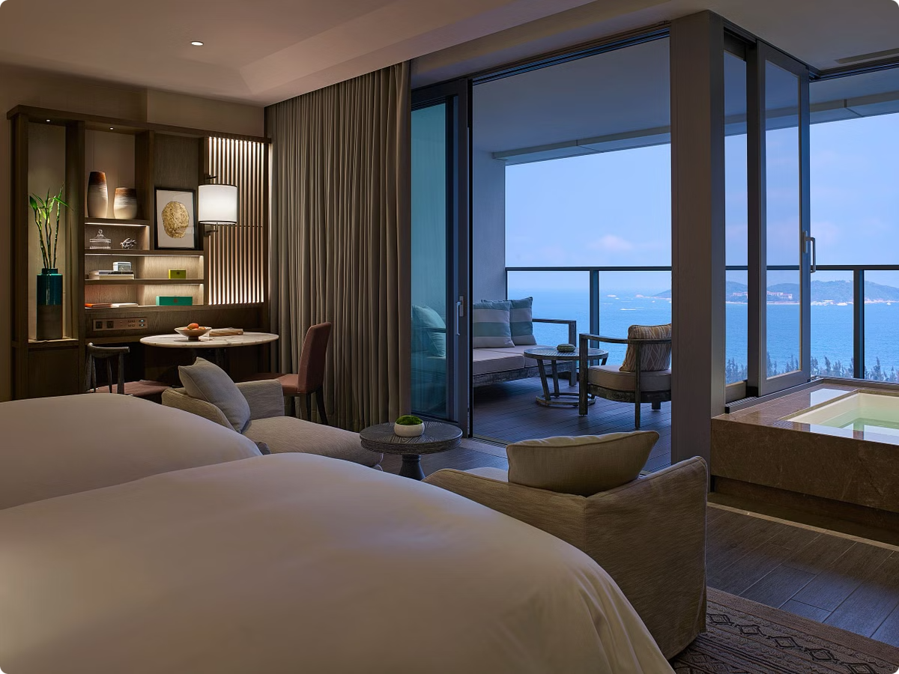
Conclusion
The development of this hotel booking system will create a positive impact on both customers and hotel operations.
The system will provide a convenient and efficient booking experience for customers, while also enabling hotels to better manage their resources and improve overall operational efficiency.

Slide 8
Thank You

